Slide 1
Presents:

Slide 2
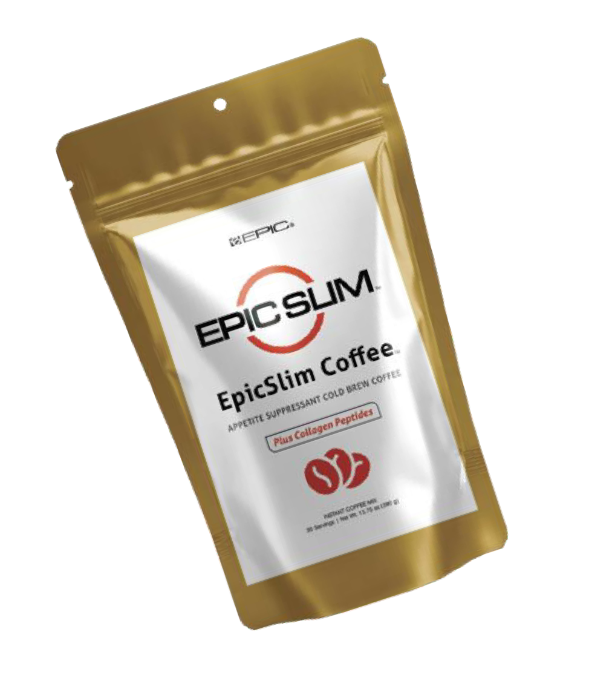
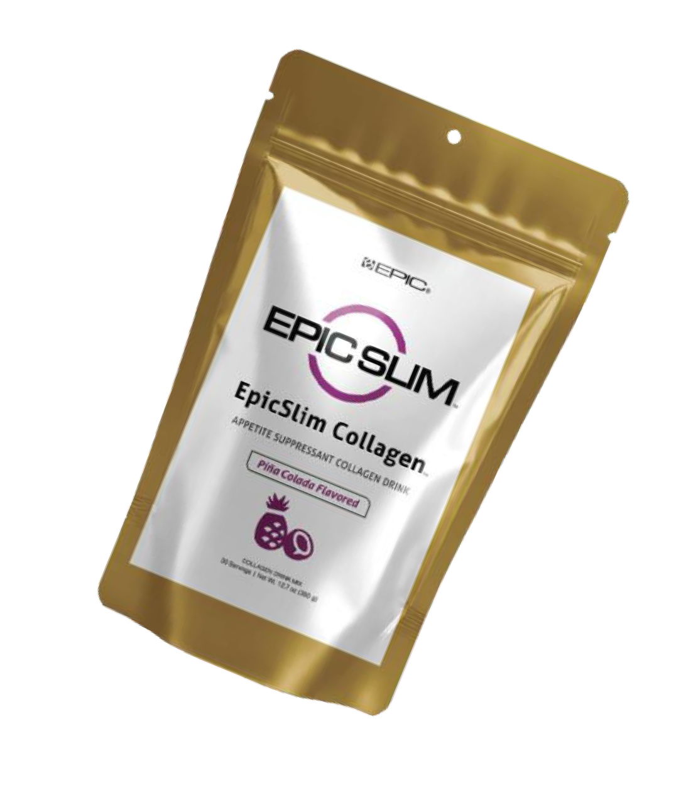
THE NEXT BIG EPIC PRODUCT
IT’S NOT JUST A PRODUCT
THE PRODUCTS AND THE CLAIMS MADE ABOUT SPECIFIC INGREDIENTS ON OR THROUGH THE SITE AND COMPANY HAVE NOT BEEN EVALUATED BY THE U.S. FOOD AND DRUG ADMINISTRATION. THE PRODUCTS ARE NOT INTENDED TO DIAGNOSE, TREAT, CURE, OR PREVENT ANY DISEASE OR MEDICAL CONDITION. AII information provid ed is for informationaI purposes onIy
and is not inten ded as a substitute for informed medicaI advice or care or any information contained on or in any product IabeI or packaging. You shouId not use the information on the Site or provided by the Company for diagnosis or treatment of any hea Ith probIem. You are advis ed to consuIt your heaIthcare provider before using any heaIth suppIement.

Slide 3
THE NEXT BIG EPIC PRODUCT
IT IS AN ENTRIE TURN KEY SYSTEM
BUSINESS OPPORTUNITY
WITH UNLIMITED POTENTIAL
BACK BY AN 8-YEAR-OLD DEBT FREE COMPANY
THE PRODUCTS AND THE CLAIMS MADE ABOUT SPECIFIC INGREDIENTS ON OR THROUGH THE SITE AND COMPANY HAVE NOT BEEN EVALUATED BY THE U.S. FOOD AND DRUG ADMINISTRATION. THE PRODUCTS ARE NOT INTENDED TO DIAGNOSE, TREAT, CURE, OR PREVENT ANY DISEASE OR MEDICAL CONDITION. AII information provid ed is for informationaI purposes onIy
and is not inten ded as a substitute for informed medicaI advice or care or any information contained on or in any product IabeI or packaging. You shouId not use the information on the Site or provided by the Company for diagnosis or treatment of any hea Ith probIem. You are advis ed to consuIt your heaIthcare provider before using any heaIth suppIement.

Slide 4
Family owned - We're passionate about
being a world-class brand and business.
We're committed to staying on the cutting-edge to ensure our members have the best products and business opportunity for the long term.
USA-Based Company Founded in November of 2016 with 10's of Millions in sales since then!

Slide 5
EPIC SLIM Products are Made to the Highest Standards EPIC SLIM manufacturer is gmp and nsf certified Less than 1% have these certifications in the USA.

Slide 6
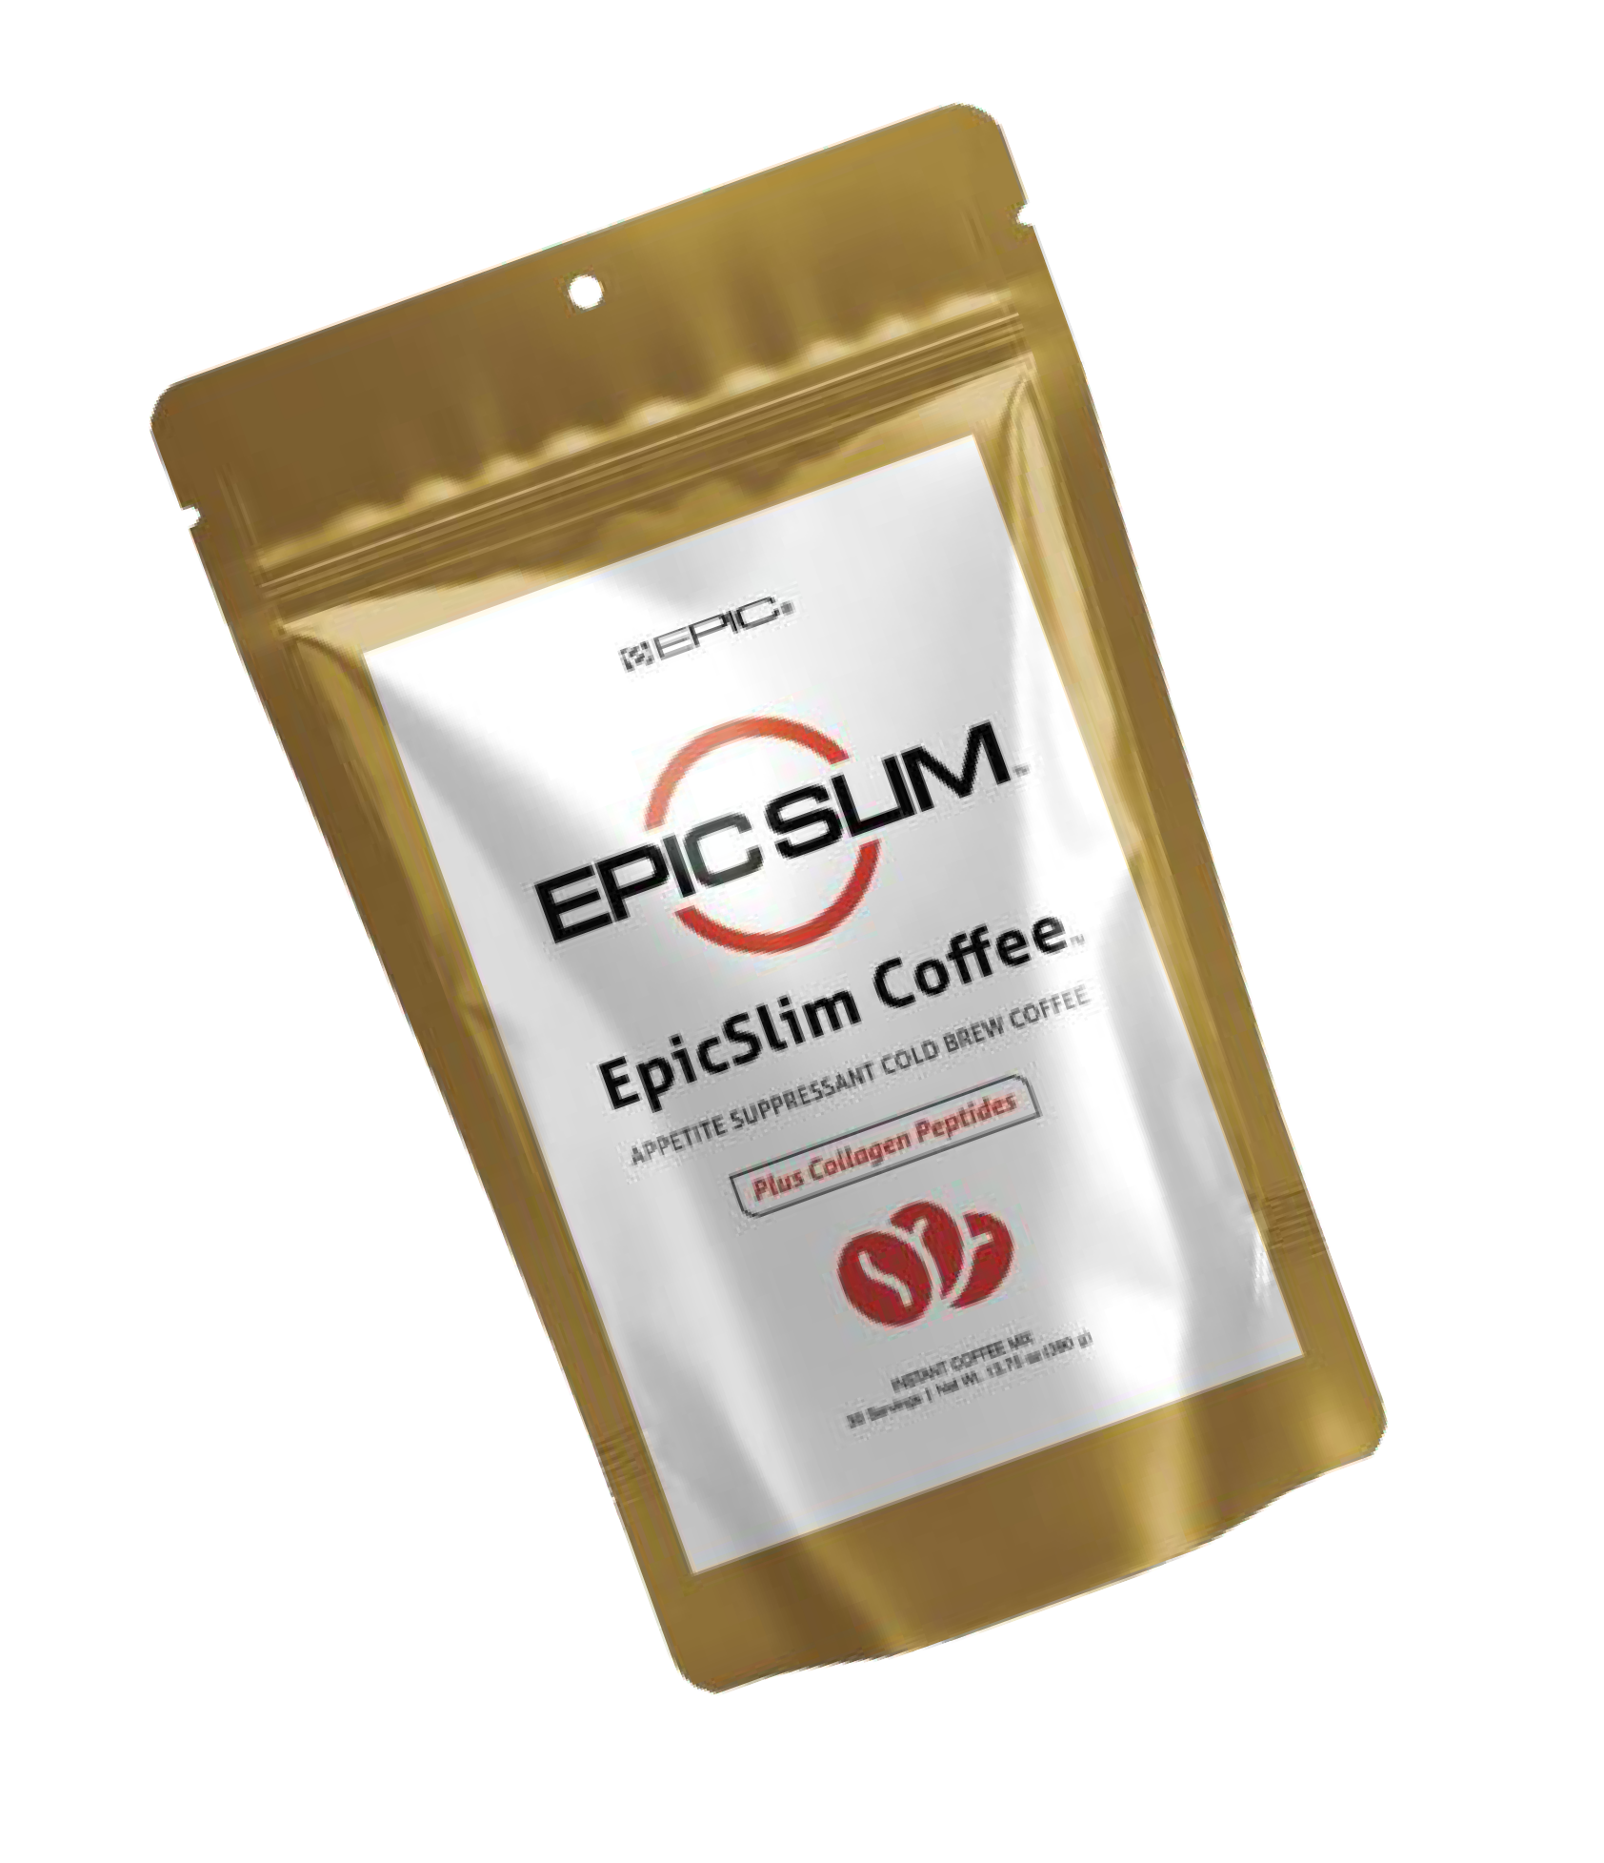
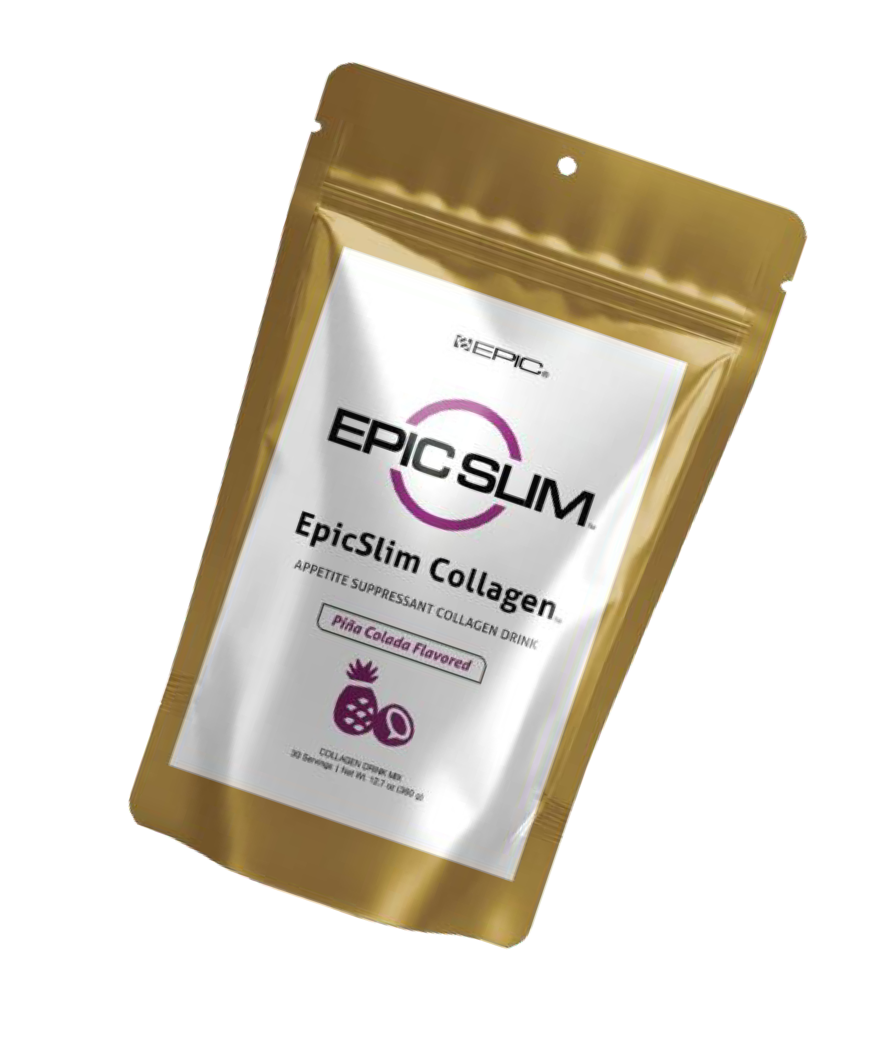

Slide 7
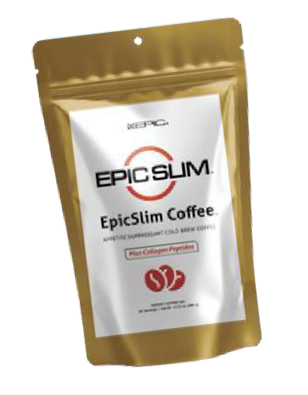
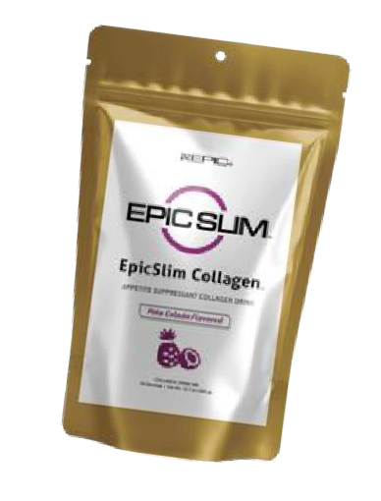
EpicSlim CollagenTM is made with premium collagen protein peptides (10 grams per serving) packed with amino acids—the building blocks of life—that support joint comfort and mobility, strengthen bones, and aid in muscle recovery and repair, helping you be active and full of life. It also helps rejuvenate skin, hair, and nails for a youthful appearance.
It also contains Berberine HCl, a plant-derived compound with remarkable therapeutic properties and extensive scientific backing shown to support healthy metabolism, gut microbiome, and blood sugar and cholesterol levels, and effective in helping maintain healthy weight.
Every serving also includes functional mushrooms long celebrated in traditional medicine
and backed by research for their adaptogenic, antioxidant, and anti-inflammatory properties. Cordyceps enhances energy, endurance, and recovery from physical activity, while Lion’s Mane improves memory, focus, and mental clarity.
Additionally, our exclusive formula features CaloriBurn GP®, a natural, non-stimulatory thermogenic from grains of paradise extract with fast-acting, long-lasting effects, proven to
significantly boost metabolic rate, activate fat burning, and increase calorie expenditure. With every delicious sip of EpicSlim CollagenTM, you’re nourishing your body with science-backed, nutrient-rich ingredients. ®
Fuel your healthy lifestyle goals! BENEFITS MAY INCLUDE:
Boosts Energy, Mood, Focus, and Productivity
Promotes Healthy Weight Management
Protects Against the Effects of Aging
Fuels Performance, Supports Recovery
Supports Brain Health, Immune Health, and Digestive Health
PRODUCT DETAILS:
All-Natural Instant Cold Brew Arabica Coffee
Contains ~75mg of Caffeine Per Serving
Provides 10g of Collagen Per Serving (Types I
& III, 92% protein, no fillers)
Includes Berberine HCl, Cordyceps, Lion’s
Mane, and CaloriBurn GP®
Provides 19 Amino Acids
CoIIagen peptides provide 19 amino acids, which may heIp support heaIthy joints, bones, skin, hair, and gut heaIth:
GIycine HydroxyIysine L−AIanine L−Arginine L−Aspartic Acid L−GIutamic Acid
L−Histidine L−HydroxyproIine L−IsoIeucine L−Leucine L−Lysine L−Methionine L−PhenyIaIanine L−ProIine L−Serine L−Threonine L−Tyrosine L−VaIine

Slide 8
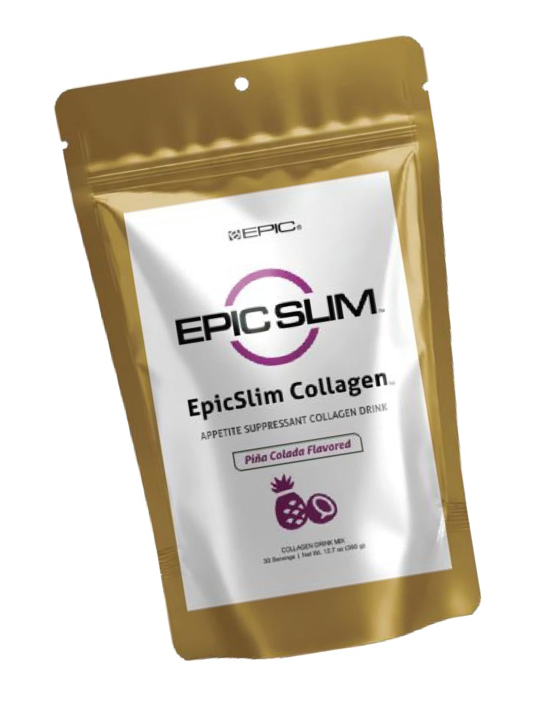
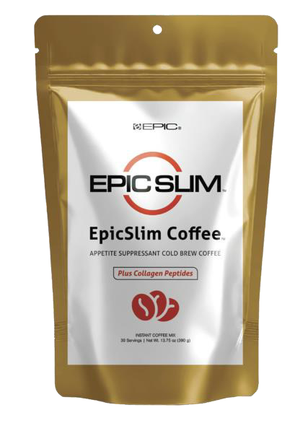
Increases metabolic rate (i.e., caloric expenditure) in a small, potent dose
Activates the metabolically active, highly thermogenic Brown Adipose Tissue (BAT)
Non-stimulatory thermogenic that’s safe to use any time of day
Long history of use in food supply with a strong safety profile
Increase Calories burn by 500%
CaloriBurn GP® is 100% Aframomum Melegueta (grains of paradise) extract, which is ethanol and water extracted through a natural proprietary technology with HPLC & HPTLC standards.
It preserves ALL the metabolism-enhancing bioactive compounds from human studies: 6-Paradol, 6-Shogaol, and 6-Gingerol. Grains of paradise has been shown to increase energy expenditure and improve body composition in humans.
CaloriBurn GP® has been shown to effectively activate BAT (Brown Adipose Tissue), which is a very unique type of fat cell that is both thermogenic and metabolically active, burning calories rather than storing them like typical White Adipose Tissue (WAT).
BAT is increasingly recognized as a powerful metabolic target, playing a significant role in the regulation of body composition and energy expenditure.

Slide 9
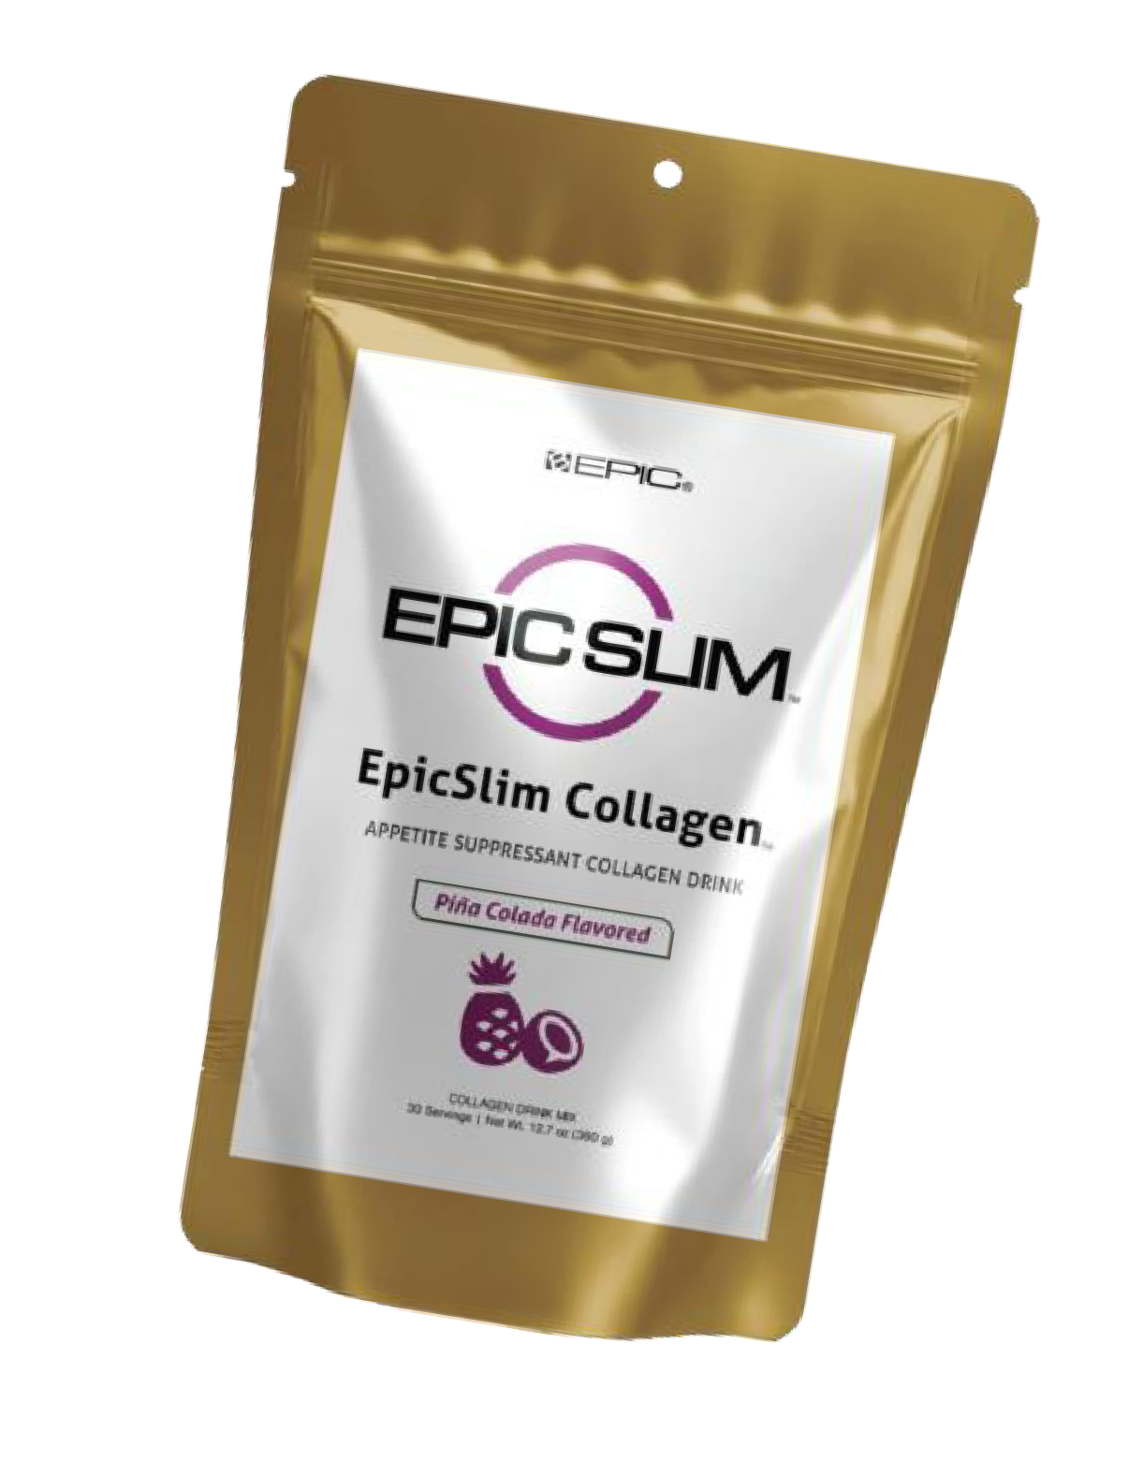

Slide 11
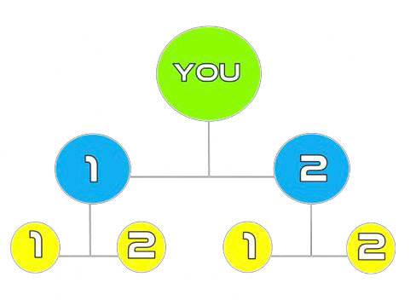
Your Next Move
Get Back with the Person that Invited You!
Step 1:
Grab Your Spot
Choose Your Flavor
Coffee of Tropical
Step 2:
Follow our BLUEPRINT
And Get 2 Business Partners
Step 3:
Help Your 2
Find Your 2

Slide 12
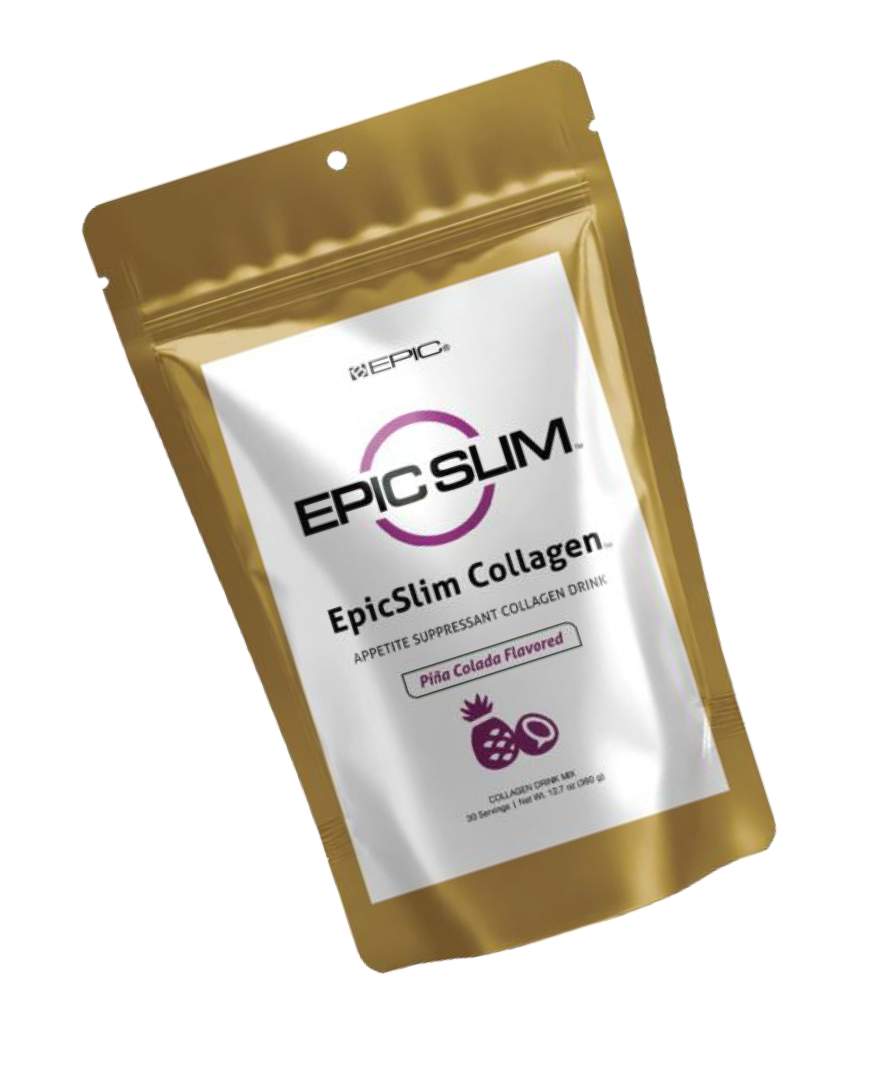
FINANCIAL RELIEF
RETAIL:
50% Instant Pay
$55 Product = $27.50 Commission

Slide 13
OUR SYSTEM
DUPLICATE 4X’S
That will put you to
$5000 - $10000 a Month
DUPLICATE 6X’S
That will put you to
$40000 - $50000 a Month
B−EPIC makes no income claims or guarantees that you will earn money becoming an distributor. The success or failure or each Individual depends upon each distributors skills and personal effort. Any and all claims or representations as to income earnings on this Site are not to be considered as average earnings. Testimonials are not representative. There can be no assurance that any prior successes or past results as to income earnings can be used as an indication of your future success or results.. All affiliates/independent distributors understand before joining or purchasing any product that there are NO guaranteed earnings. Moreover, all income information on the Site and/or from the Company is provided only to explain how the pay plan works.

Slide 14
Two Team Pay
Sponsoring Matching Bonus
Generation Matching Bonus
Global Bonus Pool
Diamond Plus Bonuses
B−EPIC makes no income claims or guarantees that you will earn money becoming an distributor. The success or failure or each Individual depends upon each distributors skills and personal effort. Any and all claims or representations as to income earnings on this Site are not to be considered as average earnings. Testimonials are not representative. There can be no assurance that any prior successes or past results as to income earnings can be used as an indication of your future success or results.. All affiliates/independent distributors understand before joining or purchasing any product that there are NO guaranteed earnings. Moreover, all income information on the Site and/or from the Company is provided only to explain how the pay plan works.

